Slide 1
Netflix Data Analysis Project
Name: Pushpalatha J S Department: MCA (VTU) Semester:Third
USN: 1BO23MC033

Slide 2
Outline
Title Name
Outline
Abstract
Problem Statement
Proposed Solution
Short Video
Implementation
Output Screenshots
References

Slide 3
Abstract:
The Netflix Data Analysis Project focuses on uncovering insights from Netflix's extensive catalog of movies, TV shows, and user interaction data to better understand viewing patterns, content trends, and user preferences.
Key objectives include:
Content Trends Analysis
Recommendation System Enhancement
User Behaviour Insights

Slide 4
Problem Statement
With the rapid growth of the streaming industry, Netflix has amassed a vast collection of content and user data.
However, effectively leveraging this data to enhance user satisfaction, improve content recommendations, and drive strategic decisions remains a challenge.
Content Trends Analysis
Recommendation System Enhancement
User Behaviour Insights

Slide 5
Proposed Solution
Loading the Dataset: Import and explore the Netflix dataset.
Data Pre-processing:
Handle missing values. Encode categorical variables. Address any class imbalance.
Feature Splitting: Divide the data into training and testing subsets.
Model Training: Use logistic regression to train the model.
Evaluation: Assess model performance using:
Accuracy
Classification Report
Confusion Matrix

Slide 6
Short Video
https://drive.goodgle.com/file/d/1BIV7AoA1VfCcNAzE632XUe6Uhd4_VYlu/view?usp=sharing

Slide 7
Implementation
https://github.com/pushpalathajspushpa

Slide 8
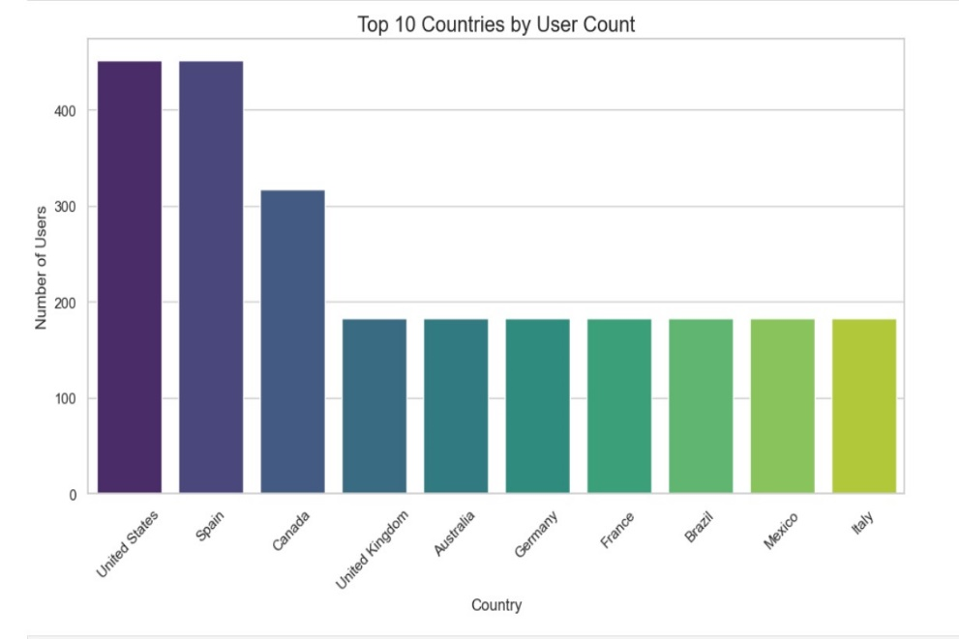
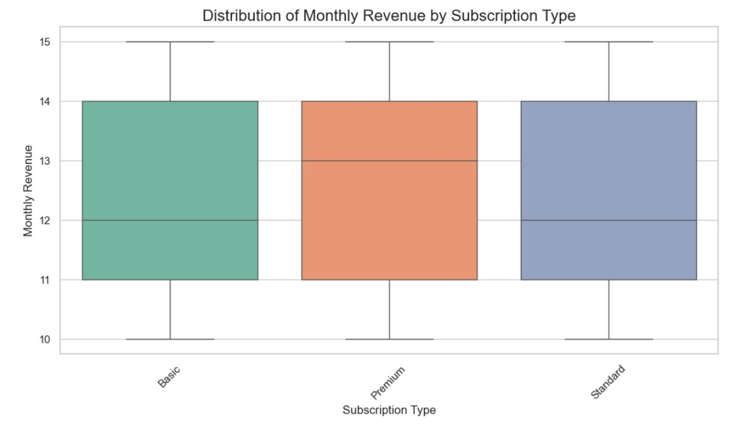
Output

Slide 9
